Slide 1
Did the rate of Covid-19 vaccinations impact the unemployment rate in the US?
By: Byron Pineda

Slide 2
This analysis examined whether the rate of Covid-19 vaccinations administered play a role with the reduction of unemployment numbers in the US.
A common theme we have heard from our government and health officials almost on a regular basis is getting vaccinations out there and "getting shots in the arms" would be a key to getting back to normalcy, reducing transmission rate, reducing death rates, and getting our economy back on track.
Simply getting vaccinated alone would not end the pandemic but would be one of the measures to reduce the impact it has had on our lives and economy.
Between January and April 2020 over 22.1 million jobs were lost.
The unemployment rate was over 14 percent.
Operation “War Speed” was launched soon afterwards at a cost estimated at $10 billion in a race to bring vaccinations to market in under a year. By the end of December, the US had 3.1 million Covid vaccinations administered.
Clearly other measures played a more immediate role in improving the unemployment rates since April 2020 as vaccinations were not available in numbers until December 2020.
The most palpable measure were most likely the three rounds of economic stimulus checks starting in April 2020 and again in December 2020 and again extended into the summer of 2021. It has been estimated that as many as 158 million households received some form of economic stimulus.
Other factors were probably companies/businesses adapting their business models when possible, people working remotely, people voluntarily not rejoining the workforce and no longer being counted as unemployed, and other factors going beyond this study.
The number of Covid vaccinations administered was used for this study and not the amount delivered. The reason for using the administered vaccinations numbers is even though there were more vaccines delivered if they were not administered then those had no impact. The data on vaccination administered was sourced from the Center for Disease Control.

Slide 3
Our findings were after running correlation that as more Covid vaccinations were administered there was a decrease in the unemployment rate.
The correlation coefficient computed for this comparison was -.86 which is a very strong indicator that there is a relationship between these two variables.
Correlation does not imply causality even if there is a strong correlation between the two variables! The correlation coefficient simply represents the degree of association between two sets of measurements.
Then we looked at linear regression. In this analysis the R-squared was 0.75 indicating a fairly strong relationship. The higher R-squared values represents smaller differences between the observed and fitted values.
The p-value obtained here was 0.0120998 which is well below the standard <.05. If we obtained a large p-value, it would suggest that changes in the predictor (vaccinations administered) are not associated with changes in the response (unemployment rate). However, in this case the small p-value equates to changes in the predictor value (vaccinations administered) are related to changes in the response variable (unemployment rates).
From our analysis, at least from a mathematical perspective, the more administered vaccinations are related to unemployment numbers decreasing.

Slide 4
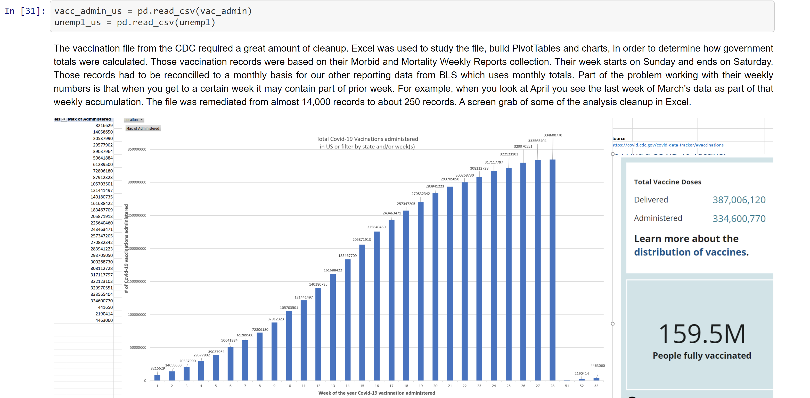

Slide 5
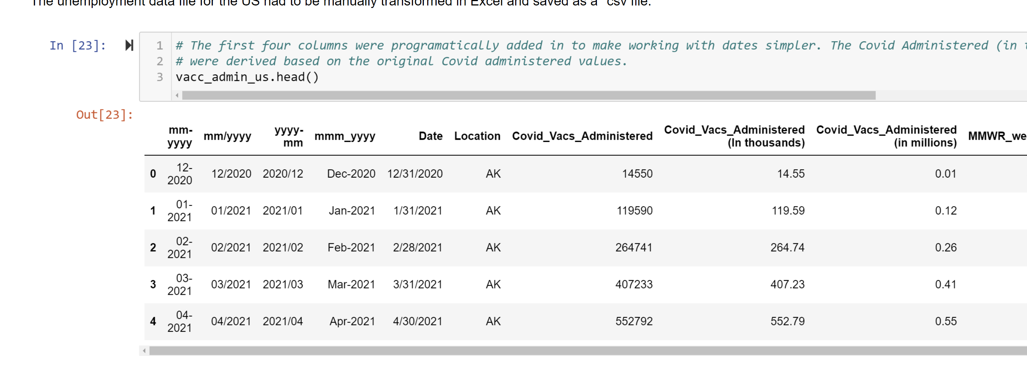

Slide 6
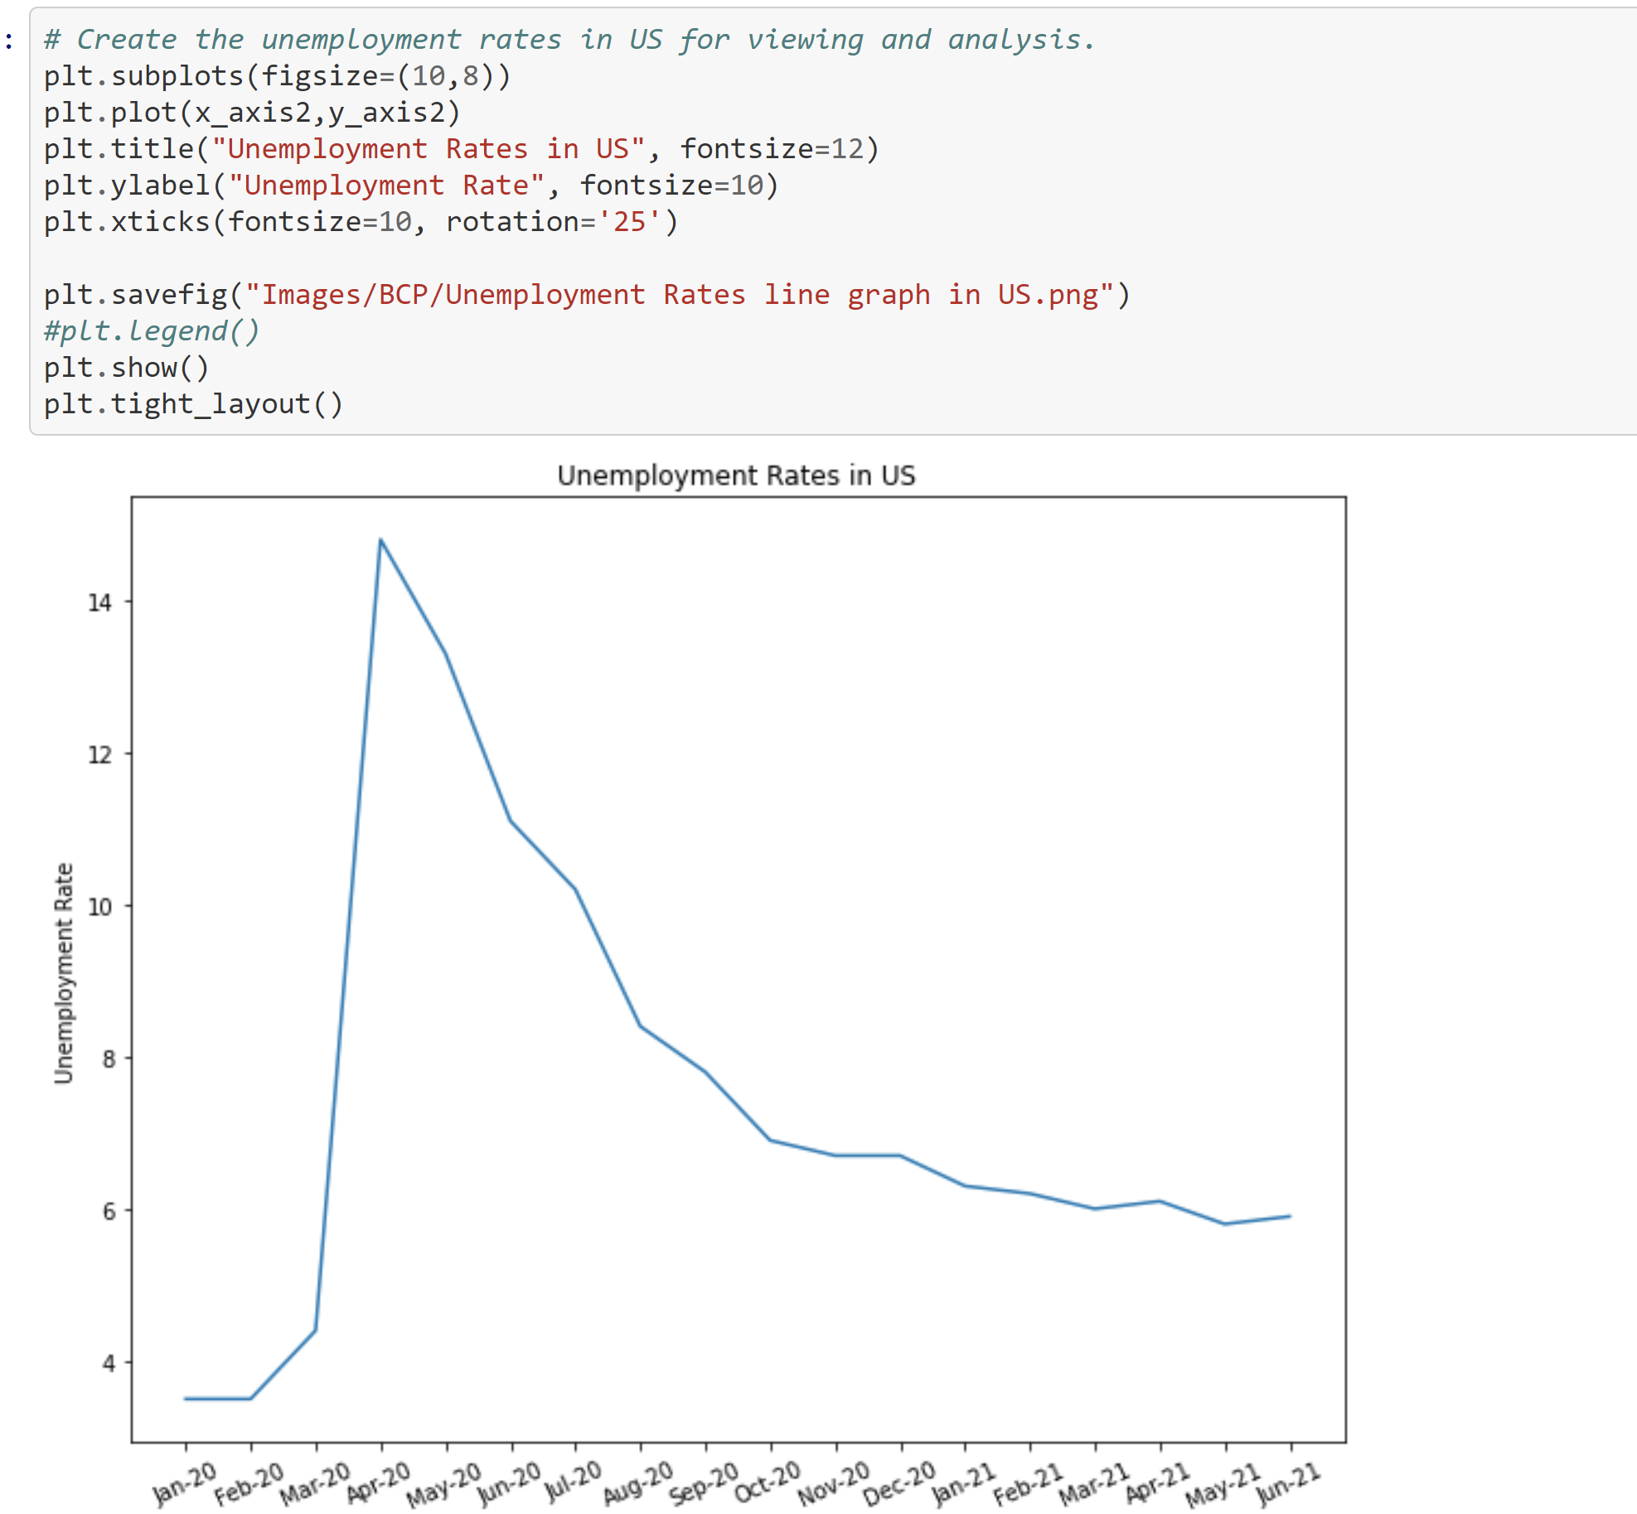

Slide 7
The vaccination file remediated earlier was used in conjunction with the unemployment file to produce the graph below.
For this graph subplots were used to set two different graphs on one plot.
The vaccination data had to be scaled down to 10 millions to work with the unemployment figures which ranged from roughly 4 to 14 percent. Vaccination data is pictured in blue. Unemployment rate was colored in red and not scaled down.
Two different x-axis and two different y-axis were used for this with vaccination data available from December 2020 - July 2021 and unemployment data available from January 2020 - June 2021. In the next graph we will zone in on the more macro view from December 2020 - June 2021.

Slide 8
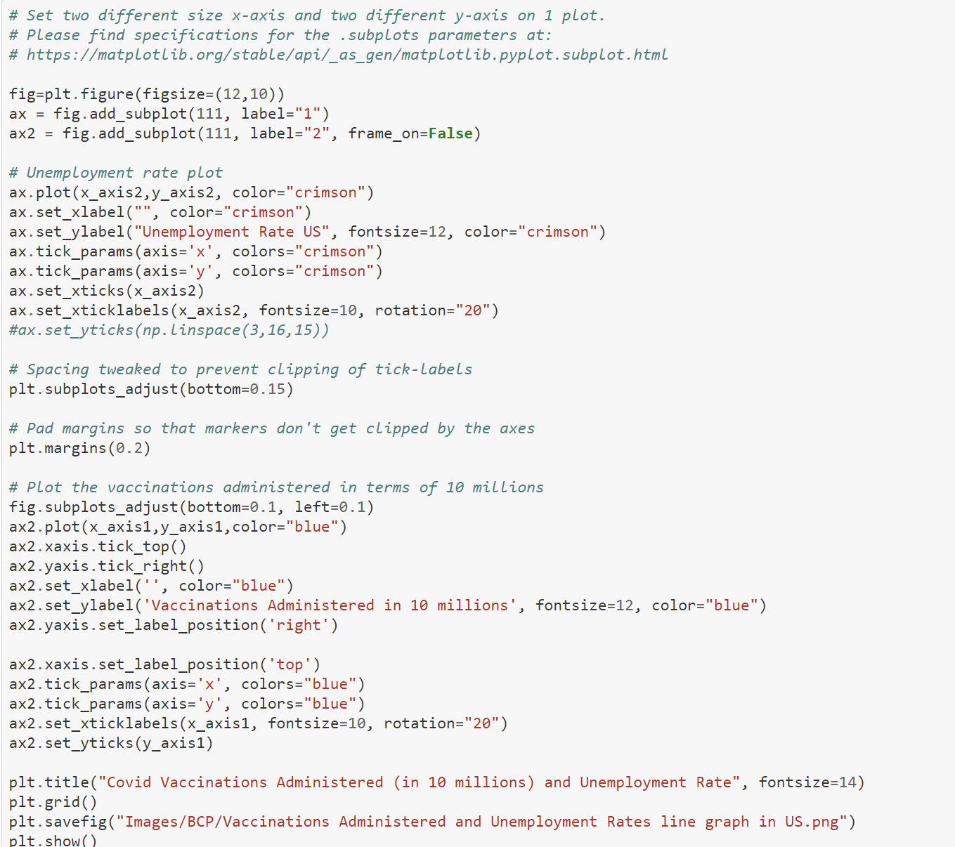

Slide 9
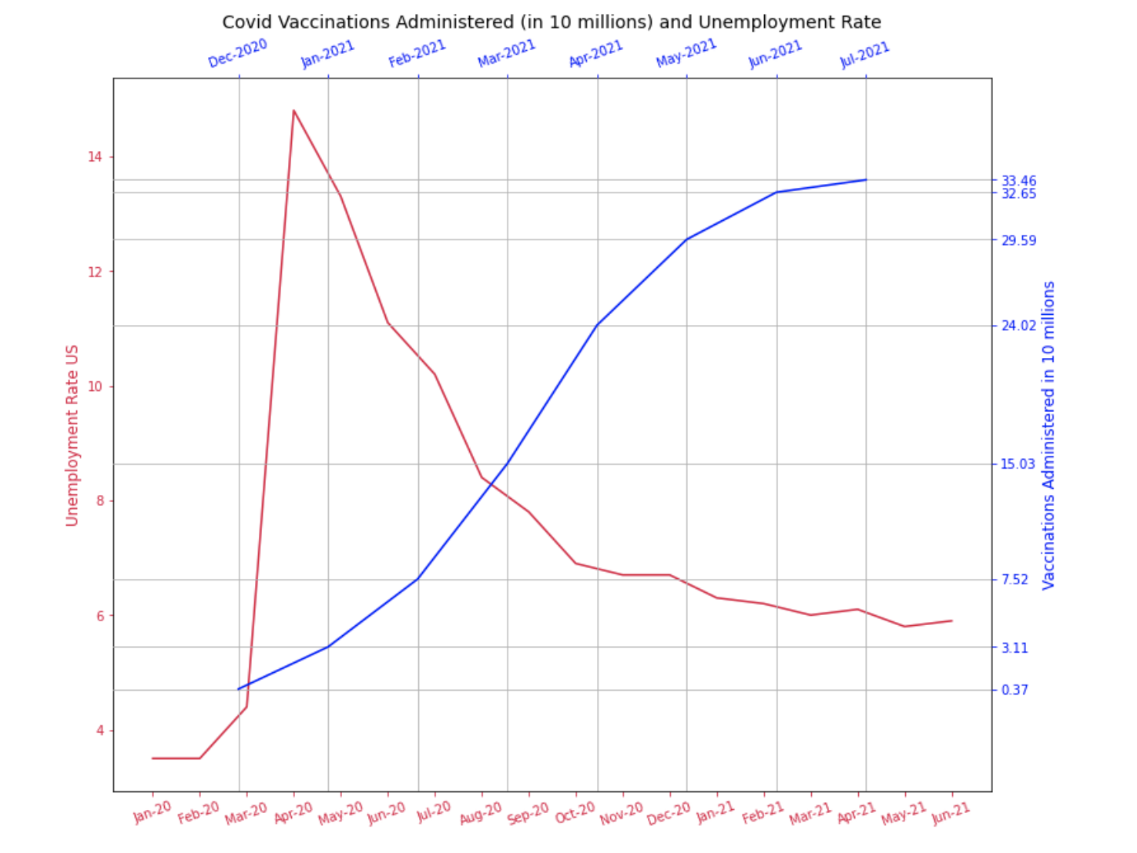

Slide 10
Vaccinations administered data was only available from December 2020 through July 2021. Unemployment numbers were available from January 2020 through June 2021. In order to take a closer look at what was happening when vaccinations were administered and its effect on unemployment we had to "throw out" some members of our data set. That meant keeping data from December 2020 through June 2021 and discarding the other data elements. This data would also be used for correlation analysis.
The graph below represents a closer look at unemployment rate versus vaccinations administered in the time period described above. In this case only data from December 2020 through June 2021 was used to give us a magnified view of that crucial period.
On the upper right-hand side, I added in annotation to give a sense of what the job growth/reduction (in millions) looked like for each month. The small percentage in changes to unemployment rates each month might not look like much but there was a steady number of job additions during that period.
Also, the annotation above the vaccines (x-axis) lets you know which month it is associated with for clarification. For example, the difference in number of jobs added between January 21 and March 2021 was approximately 1.12 million additions and difference between April 2021 - May 2021 was an addition of approximately 940K. So although these may look like insignificant reductions in unemployment rate the difference can account for a lot of job additions.

Slide 11
In some cases, the difference between December 2020 and January 2021 lost about 700K jobs but shows a reduction of unemployment rate. Part of this may be employees no longer being considered as unemployed because of a voluntary decision not to return to work.
There was a slight rate of unemployment increasing from 6.0 to 6.1 percent between March 2021 and April 2021 even though the jobs increased by approximately 800K. From May 2021 to June 2021 there was an increase of about 580K jobs, but the unemployment rate jumped from 5.8 to 5.9 percent.
In general, the plot shows that as vaccinations increased so did the rate of unemployment.

Slide 12
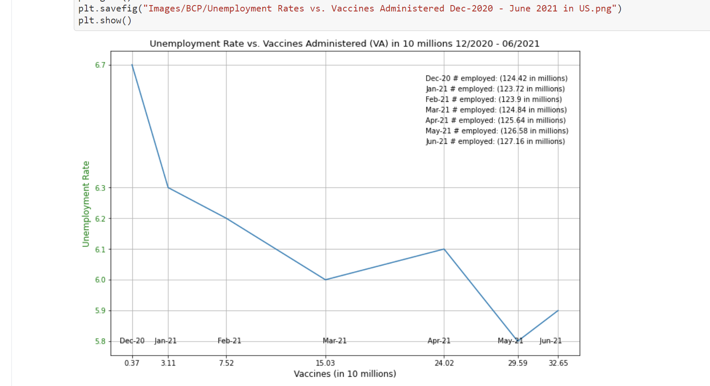

Slide 13
A negative or inverse correlation describes a relationship between two variables that move in opposing directions. Or you can think of this as one variable increases (vaccines administered), then the value of the other variable (unemployment rates) decreases. In this case, as more Covid vaccinations were administered there was a decrease in the unemployment rate.
A correlation coefficient with an absolute value of .75 is considered a strong relationship. The correlation coefficient computed for this comparison was -.86 which is a very strong indicator that there is a relationship between these two variables.
Correlation does not imply causality even if there is a strong correlation between the two variables! The correlation coefficient simply represents the degree of association between two sets of measurements.

Slide 14
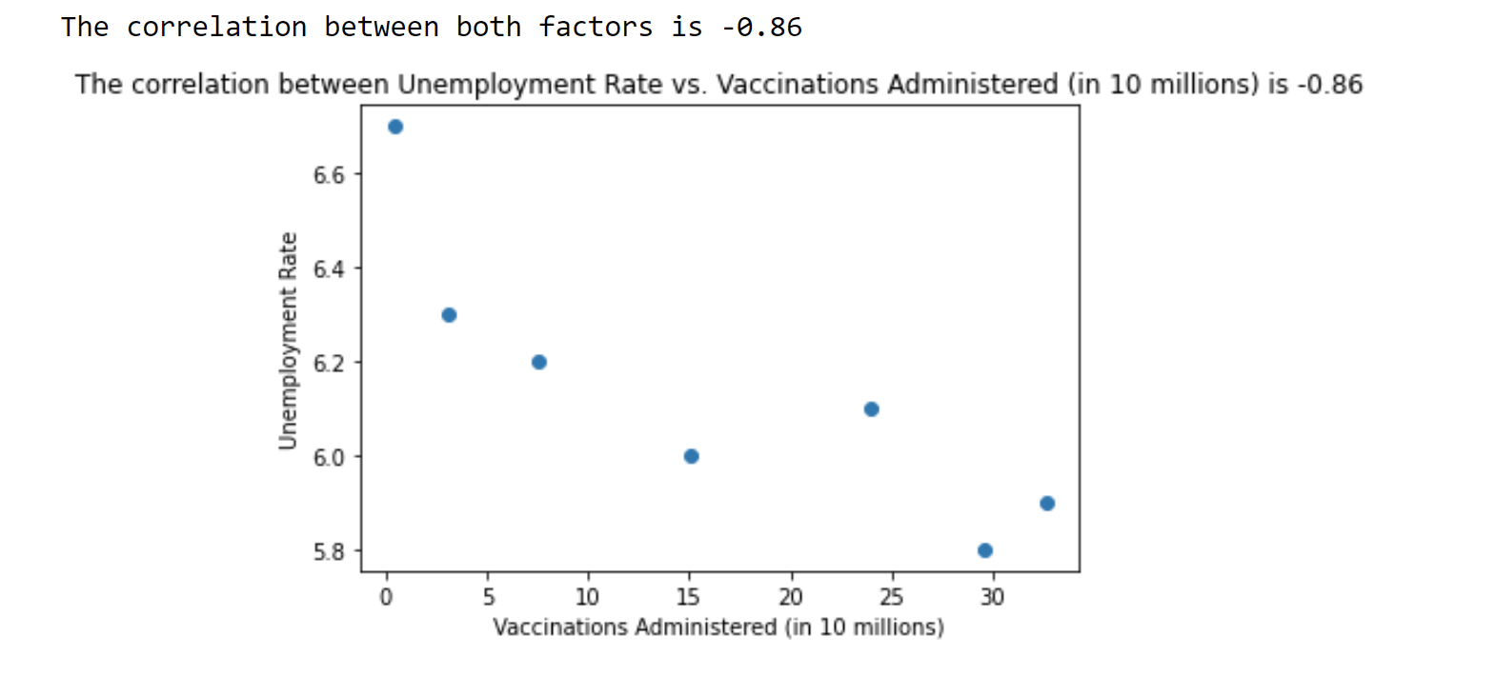

Slide 15
Calculate and show the linear regression equation and line to plot.
The mathematical formula is composed of a response variable (y), in this case the unemployment rate, and the predictor variable (x) or the vaccinations administered. The formula predicts in this case unemployment rate, when vaccinations administered values are known.
In general, higher R-squared values represent smaller differences between the observed and fitted values. In this analysis the R-squared was 0.75 indicating a fairly strong relationship.
The p-value obtained here is 0.0120998 which is well below the standard <.05. If we obtained a large p-value, it would suggest that changes in the predictor (vaccinations administered) are not associated with changes in the response (unemployment rate). However, in this case the small p-value equates to changes in the predictor value (vaccinations administered) are related to changes in the response variable (unemployment rates).

Slide 16
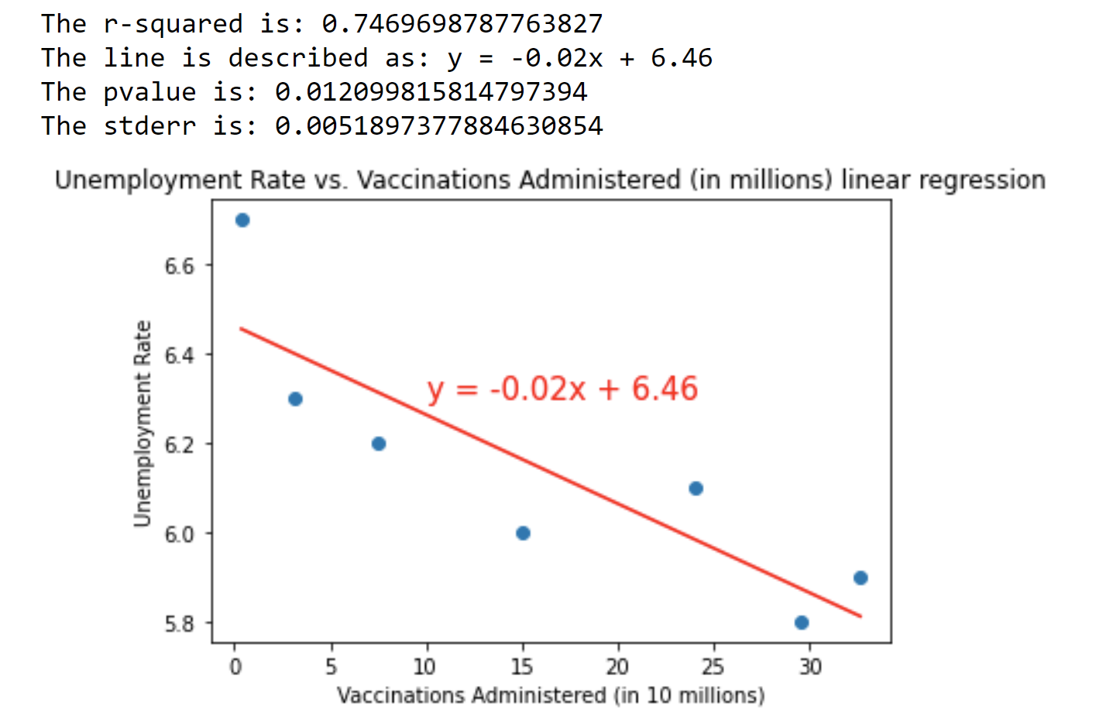

Slide 17
The End

